Slide 1
Java Tutorial
Java is a high-level programming language originally developed by Sun Microsystems and released in 1995. Java runs on a variety of platforms, such as Windows, Mac OS, and the various versions of UNIX. This tutorial gives a complete understanding on Java.
This reference will take you through simple and practical approach while learning Java Programming language.
Prerequisites
Before you start doing practice with various types of examples given in this reference, I'm making an assumption that you are already aware about what is a computer program and what is a computer programming language.

Slide 2
Where It Is Used
According to Sun, 3 billion devices run Java. There are many devices where Java is currently used. Some of them are as follows:
1. Desktop Applications such as acrobat reader, media player, antivirus etc.
2. Web Applications such as irctc.co.in
3. Enterprise Applications such as banking applications.
4. Mobile
5. Embedded System
6. Smart Card
7. Robotics
8. Games etc.

Slide 3
Types Of Java Applications
There are mainly 4 type of applications that can be created using Java:
1) Standalone Application
It is also known as desktop application or window-based application. An application that we need to install
on every machine such as media player, antivirus etc. AWT and Swing are used in Java for creating
standalone applications.
2) Web Application
An application that runs on the server side and creates dynamic page, is called web application. Currently,
servlet, jsp, struts, jsf etc. technologies are used for creating web applications in Java.

Slide 4
Cont..
3) Enterprise Application
An application that is distributed in nature, such as banking applications etc. It has the advantage of high
level security, load balancing and clustering. In Java, EJB is used for creating enterprise applications.
4) Mobile Application
An application that is created for mobile devices. Currently Android and Java ME are used for creating mobile
applications.

Slide 5
Java Overview
Java programming language was originally developed by Sun Microsystems, which was initiated by James Gosling and released in 1995 as core component of Sun Microsystems Java platform (Java 1.0 [J2SE]).
As of December 08 the latest release of the Java Standard Edition is 6 (J2SE).
With the advancement of Java and its wide spread popularity, multiple configurations were built to suite various types of platforms.
Ex: J2EE for Enterprise Applications, J2ME for Mobile Applications.

Slide 6
Features of Java
I. Simple
2. Object-oriented
3. Platform independent
4.Secured
5. Robust
6. Architecture neutral
7. Portable
8. Dynamic
9.Interpreted
10.High Performance
11. Multithreaded
12.Distributed

Slide 7
Features Of Java
Object Oriented : In java everything is an Object. Java can be easily extended since it is based on the Object model.
Platform independent: Unlike many other programming languages including C and C++ when Java is compiled, it is not compiled into platform specific machine, rather into platform independent byte code. This byte code is distributed over the web and interpreted by virtual Machine (JVM) on whichever platform it is being run.

Slide 8
Features Of Java Cont..
Simple :Java is designed to be easy to learn. If you understand the basic concept of OOP java would be easy to master.
Secure : With Java's secure feature it enables to develop virus-free, tamper-free systems. Authentication techniques are based on public-key encryption.
Architectural- neutral :Java compiler generates an architecture-neutral object file format which makes the compiled code to be executable on many processors, with the presence Java runtime system.

Slide 9

Features Of Java Cont..
Portable :being architectural neutral and having no implementation dependent aspects of the specification makes Java portable. Compiler and Java is written in ANSI C with a clean portability boundary means We may carry the Java byte code to any platform.
Robust : Robust simply means strong. Java uses strong memory management. There are lack of pointers that avoids security problem. There is automatic garbage collection in Java. There is exception handling and type
checking mechanism in Java. All these points makes Java robust.
Multi-threaded : With Java's multi-threaded feature it is possible to write programs that can do many tasks simultaneously. This design feature allows developers to construct smoothly running interactive applications.

Slide 10
Features Of Java Cont..
Interpreted :Java byte code is translated on the fly to native machine instructions and is not stored anywhere. The development process is more rapid and analytical since the linking is an incremental and light weight process.
High Performance: With the use of Just-In-Time compilers Java enables high performance.
Distributed :Java is designed for the distributed environment of the internet.
Dynamic : Java is considered to be more dynamic than C or C++ since it is designed to adapt to an evolving environment. Java programs can carry extensive amount of run-time information that can be used to verify and resolve accesses to objects on run-time.

Slide 11
My First Java Programme
public class MyFirstJavaProgram {
public static void main(String []args) {
System.out.println("Hello World");
}
}

Slide 12
Understanding first java program
class is used to declare a class in Java.
public is an access modifier which represents visibility, it means it is visible to all.
static is a keyword, if we declare any method as static, it is known as static method. The core advantage of static method is that there is no need to create object to invoke the static method. The main method is executed by the JVM, so it doesn't require to create object to invoke the main method.So it saves memory.
void is the return type of the method, it means it doesn't return any value, main represents startup of the program.
String[] args is used for command line argument. We will learn it later. System.out.println() is used print statement.

Slide 13
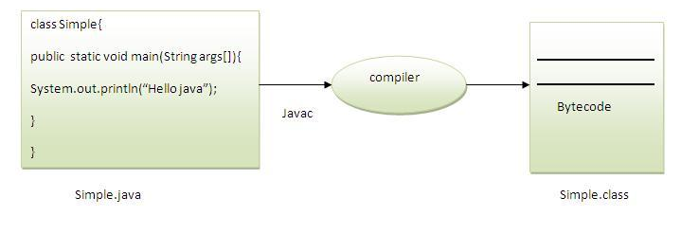
What happens at compile time?
At compile time, Java file is compiled by Java Compiler (It does not interact with OS) and converts the Java code into bytecode.

Slide 14
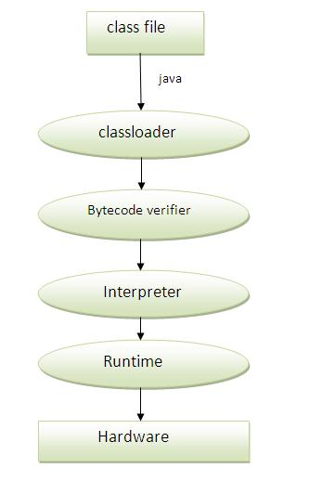
What happens at runtime?
Classloader: is the subsystem of JVM that is used to load class files.
Bytecode Verifier: checks the code fragments for illegal code that can violate accesss right to objects.
Interpreter: read bytecode stream then execute the instructions.

Slide 15
Questions
Can you save a java source file by other name than the class name?
Can you have a empty java file?
What if no one class have main function?
How to print “Hello World” without main function?
Can you have multiple classes in a java source file?

Slide 16
Java is an Object Oriented Language
As a language that has the Object Oriented feature Java supports the following fundamental concepts:
Classes
Objects
Encapsulation
Abstraction
Inheritance
Polymorphism

Slide 17
Objects
Let us now look deep into what are objects. If we consider the real-world we can find many objects around us, Cars, Dogs, Humans etc. All these objects have a state and behavior.
An object is an instance of a class. The relationship is such that many objects can be created using one class. Each object has its own data but its underlying structure (i.e., the type of data it stores, its behaviors) are defined by the class.

Slide 18
Classes
A class--the basic building block of an object-oriented language such as Java
A class is a blue print from which individual objects are created.
A class specifies the design of an object. It states what data an object can hold and the way it can behave when using the data.
Class is a template that describes the data and behavior associated with instances of that class.
The data associated with a class or object is stored in variables.
The behavior associated with a class or object is implemented with methods.(Methods are similar to the functions or procedures in procedural languages such as C).

Slide 19
Class Example
public class Book {
private String title;
private String author;
private String publisher;
public Book(String bookTitle, String authorName, String publisherName) {
title = bookTitle;
author = authorName;
publisher = publisherName;
}
//all getter and setter methods
}

Slide 20
Object Example
An instance of this class will be a book object:
Book firstBook = new Book(“Complete Reference",“ABC",“XYZ");
Objects can be created by using new keyword in java.
As mentioned previously a class provides the blueprints for objects. So basically an object is created from a class. In java the new key word is used to create new objects.
There are three steps when creating an object from a class:
Declaration . A variable declaration with a variable name with an object type. Like Book firstBook
Instantiation . The 'new' key word is used to create the object.
Initialization . The 'new' keyword is followed by a call to a constructor. This call initializes the new object.
eg. new Book();

Slide 21
More Details Of Class
A class can contain any of the following variable types.
Local variables
Instance variables
Class variables

Slide 22
Local Variable
Local variable are variables defined inside methods, constructors or blocks.
The variable will be declared and initialized within the method and the variable will be destroyed when the method has completed.
Eg.
Public void setTitle(String title){
this.title=title;
}

Slide 23
Rules For Local Variable
Local variables are declared in methods, constructors, or blocks.
Local variables are created when the method, constructor or block is entered and the variable will be destroyed once it exits the method, constructor or block.
Access modifiers cannot be used for local variables.
Local variables are visible only within the declared method, constructor or block.
Local variables are implemented at stack level internally.
There is no default value for local variables so local variables should be declared and an initial value should be assigned before the first use.

Slide 24
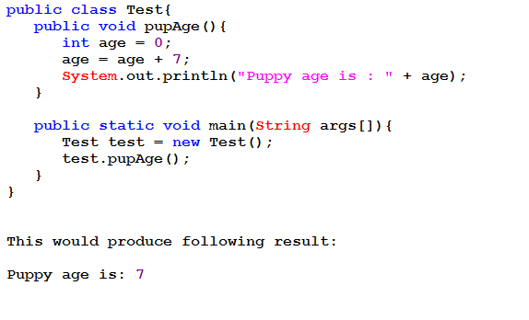
Example Of Local Variable

Slide 25
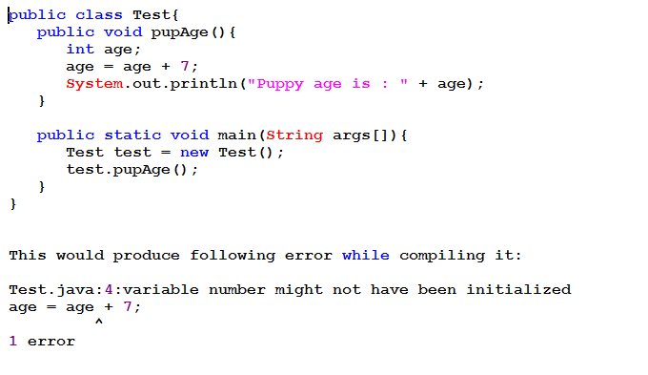
Problem With Local Variable
Following example uses age without initializing it, so it would give an error at the time of compilation.

Slide 26
Instance variables
Instance variables are variables within a class but outside any method. These variables are instantiated when the class is loaded. Instance variables can be accessed from inside any method, constructor or blocks of that particular class.
Eg.
private String title;
private String author;
private String publisher;

Slide 27
Rules For Instance Variable
Instance variables are declared in a class, but outside a method, constructor or any block.
When a space is allocated for an object in the heap a slot for each instance variable value is created.
Instance variables are created when an object is created with the use of the key word 'new' and destroyed when the object is destroyed.
Instance variables hold values that must be referenced by more than one method, constructor or block, or essential parts of an object. state that must be present through out the class.
Instance variables can be declared in class level before or after use.

Slide 28
Rules For Instance Variable
Access modifiers can be given for instance variables.
The instance variables are visible for all methods, constructors and block in the class. Normally it is recommended to make these variables private (access level).However visibility for subclasses can be given for these variables with the use of access modifiers.
Instance variables have default values. For numbers the default value is 0, for Booleans it is false and for object references it is null. Values can be assigned during the declaration or within the constructor.
Instance variables can be accessed directly by calling the variable name inside the class. However within static methods and different class ( when instance variables are given accessibility) the should be called using the fully qualified name .ObjectReference.VariableName.

Slide 29
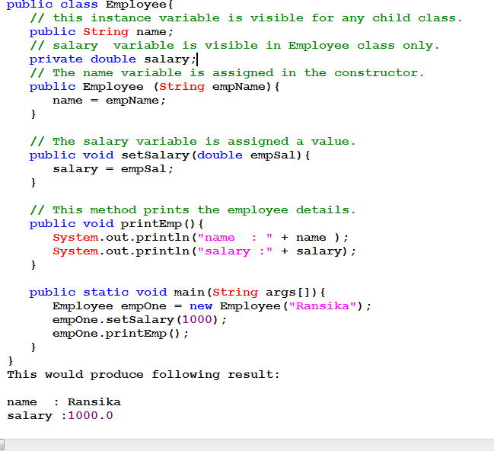
Example Of Instance Variable

Slide 30
Class variables
Class variables are variables declared with in a class, outside any method, with the static keyword.
Eg.
private static int count=0;

Slide 31
Rules For Class/Static Variable
Class variables also known as static variables are declared with the static keyword in a class, but outside a method, constructor or a block.
There would only be one copy of each class variable per class, regardless of how many objects are created from it.
Static variables are rarely used other than being declared as constants. Constants are variables that are declared as public/private, final and static. Constant variables never change from their initial value.
Static variables are stored in static memory. It is rare to use static variables other than declared final and used as either public or private constants.
Static variables are created when the program starts and destroyed when the program stops.

Slide 32
Rules For Class/Static Variable
Visibility is similar to instance variables. However, most static variables are declared public since they must be available for users of the class.
Default values are same as instance variables. For numbers the default value is 0, for Booleans it is false and for object references it is null. Values can be assigned during the declaration or within the constructor. Additionally values can be assigned in special static initializer blocks.
Static variables can be accessed by calling with the class name . ClassName.VariableName.
When declaring class variables as public static final, then variables names (constants) are all in upper case. If the static variables are not public and final the naming syntax is the same as instance and local variables.

Slide 33
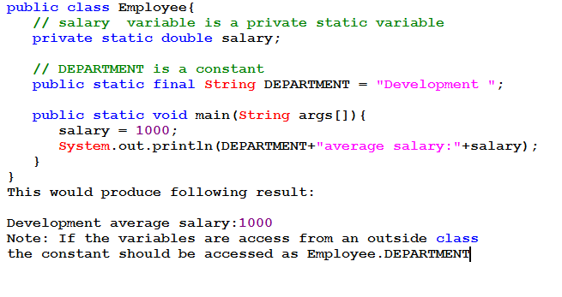
Example Of Class/Static Variable

Slide 34
A class can have any number of methods to access the value of various kind of methods.
Like Book Class can have
bookIssue()
addBook()
deleteBook()
updateBook()

Slide 35
Source file declaration rules
There can be only one public class per source file.
A source file can have multiple non public classes.
The public class name should be the name of the source file as well which should be appended by .java at the end. For example : The class name is . public class Employee{} Then the source file should be as Employee.java.
If the class is defined inside a package, then the package statement should be the first statement in the source file.
If import statements are present then they must be written between the package statement and the class declaration. If there are no package statements then the import statement should be the first line in the source file.
Import and package statements will imply to all the classes present in the source file. It is not possible to declare different import and/or package statements to different classes in the source file.

Slide 36
A Simple Case Study
For our case study we will be creating two classes. They are Employee and EmployeeTest.
First open notepad and add the following code. Remember this is the Employee class and the class is a public class. Now save this source file with the name Employee.java.
The Employee class has four instance variables name, age, designation and salary. The class has one explicitly defined constructor which takes a parameter.

Slide 37
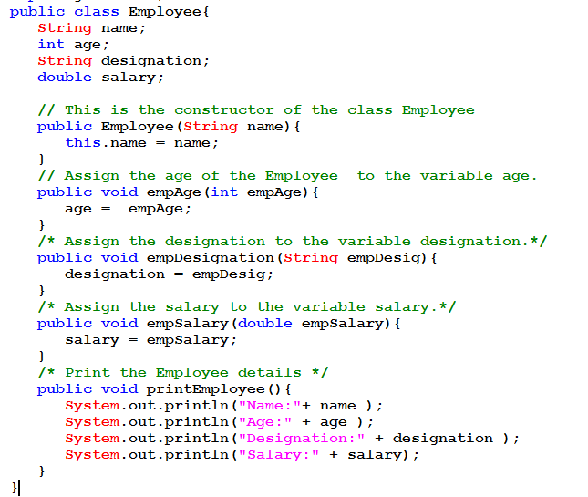
A Simple Case Study

Slide 38
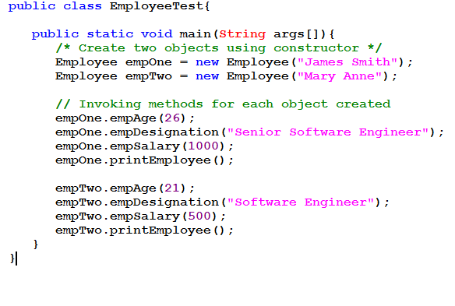
A Simple Case Study

Slide 39
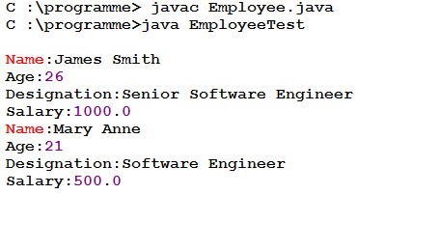
How To Run

Slide 40
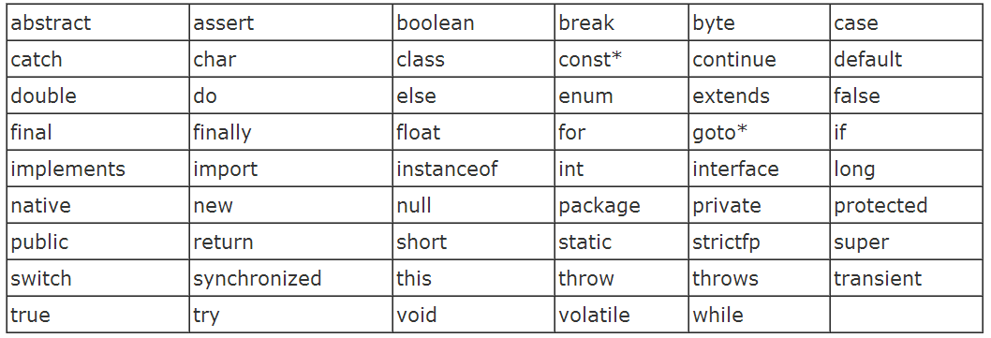
Java Keywords

Slide 41
Java Basic Datatypes
There are two data types available in Java:
Primitive Data Types
Reference/Object Data Types

Slide 42
Primitive Datatypes
Data type | Bytes | Min Value | Max Value | Literal Values
byte | 1 | -2⁷ | 2⁷ – 1 | 123
short | 2 | -2¹⁵ | 2¹⁵ – 1 | 1234
int | 4 | -2³¹ | 2³¹ – 1 | 12345, 086, 0x675
long | 8 | -2⁶³ | 2⁶³ – 1 | 123456
float | 4 | - | - | 1.0
double | 8 | - | - | 123.86
char | 2 | 0 | 2¹⁶ – 1 | ‘a’, ‘\n’
boolean | - | - | - | true, false

Slide 43
Reference Data Types
Reference variables are created using defined constructors of the classes. They are used to access objects. These variables are declared to be of a specific type that cannot be changed. For example, Employee, Puppy etc.
Class objects, and various type of array variables come under reference data type.
Default value of any reference variable is null.
A reference variable can be used to refer to any object of the declared type or any compatible type.
Example : Animal animal = new Animal("giraffe");

Slide 44
Java Modifier Types
Modifiers are keywords that you add to those definitions to change their meanings. The Java language has a wide variety of modifiers, including the following:
Java Access Modifiers
Non Access Modifiers
To use a modifier, you include its keyword in the definition of a class, method, or variable. The modifier precedes the rest of the statement, as in the following examples (Italic ones)

Slide 45
Java Modifiers
Modifier | Class | Class Variables | Methods | Method Variables
public
private
protected
default
final
abstract
strictfp
transient
synchronized
native
volatile
static

Slide 46
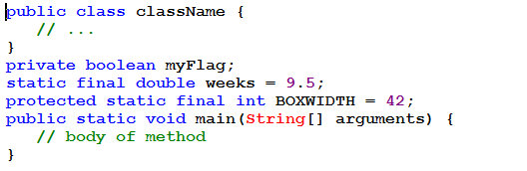
Modifier Example

Slide 47
Access Control Modifiers
Java provides a number of access modifiers to set access levels for classes, variables, methods and constructors. The four access levels are:
Default:-Visible to the package. No modifiers are needed.
Private:-Visible to the class only .
Public:-Visible to the world.
Protected:-Visible to the package and all subclasses.

Slide 48
Non Access Modifiers
Java provides a number of non-access modifiers to achieve many other functionality.
The static modifier for creating class methods and variables
The final modifier for finalizing the implementations of classes, methods, and variables.
The abstract modifier for creating abstract classes and methods.
The synchronized and volatile modifiers, which are used for threads.

Slide 49
Naming convention
A naming convention is a rule to follow as you decide what to name your identifiers (e.g. class, package,variable, method, etc.), but it is not mandatory to follow that is why it is known as convention not rule.
Advantage:
By using standard Java naming conventions they make their code easier to read for themselves and for other programmers. Readability of Java code is important because it means less time is spent trying to figure out what the code does.

Slide 50
Class Name | should begin with uppercase letter and be a noun e.g.String,System,Thread etc.
Interface Name | should begin with uppercase letter and be an adjective (whereever possible), e.g.Runnable,ActionListener etc.
Method Name | should begin with lowercase letter and be a verb. e.g.main(),print{),println(), actionPerformed() etc.
Variable Name | should begin with lowercase letter e.g. firstName,orderNumber etc.
Package Name | should be in lowercase letter, e.g. java.lang.sql.util etc.
Constant Name | should be in uppercase letter, e.g. RED,YELLOW,MAX_PRIORITY etc.

Slide 51
Method Overloading
Method overloading means when two or more methods have the same name but a different signature.
Signature of a method is nothing but a combination of its name and the sequence of its parameter types.
Advantages of method overloading
It allows you to use the same name for a group of methods that basically have the same purpose.
Method overloading increases the readability of the program.

Slide 52
Method Overloading
Different ways to overload the method
There are two ways to overload the method in Java
1. By changing number of arguments
2. By changing the data type
Note: In Java, Methood Overloading is not possible by changing return type of the method.

Slide 53
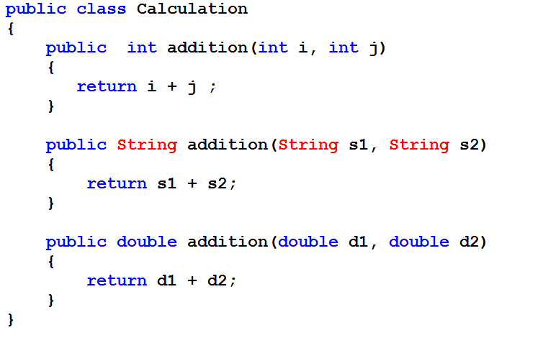

Slide 54
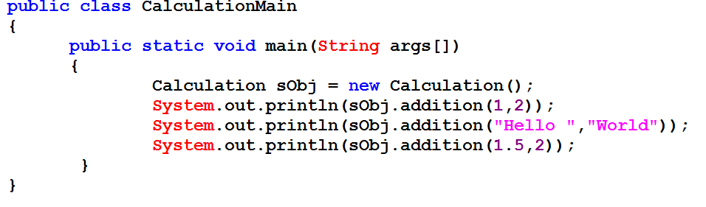

Slide 55
Questions
Que) Why Method Overloaing is not possible by changing the return type of method?
Que) Can we overload main() method?

Slide 56
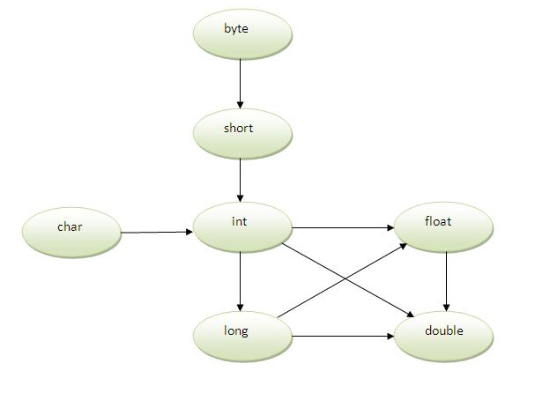
Method Overloading and Type Promotion

Slide 57
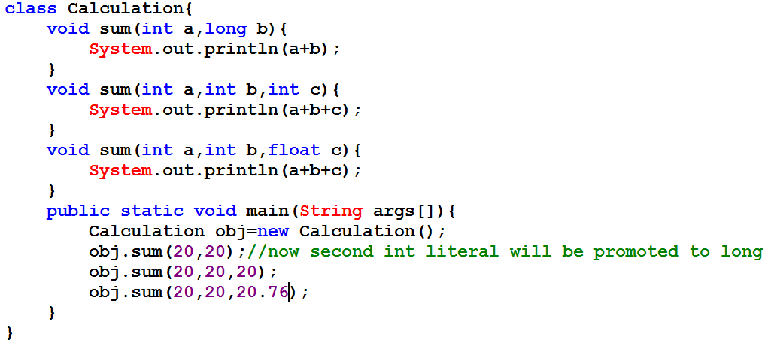
Example

Slide 58
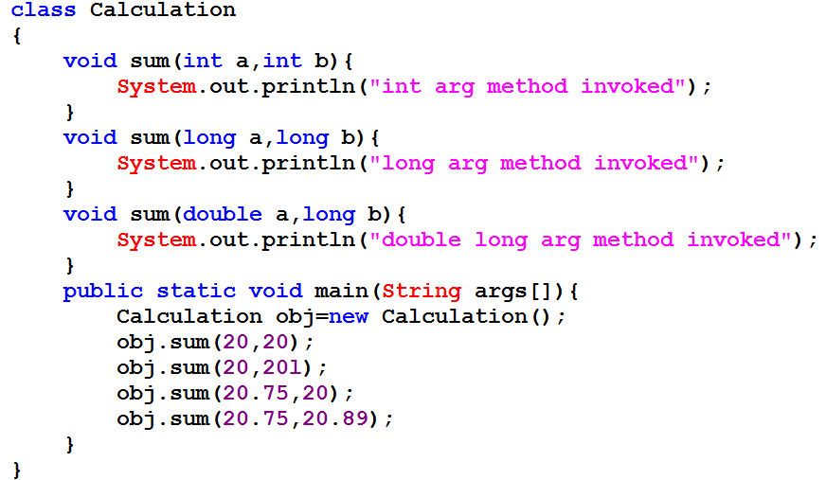
Example

Slide 59
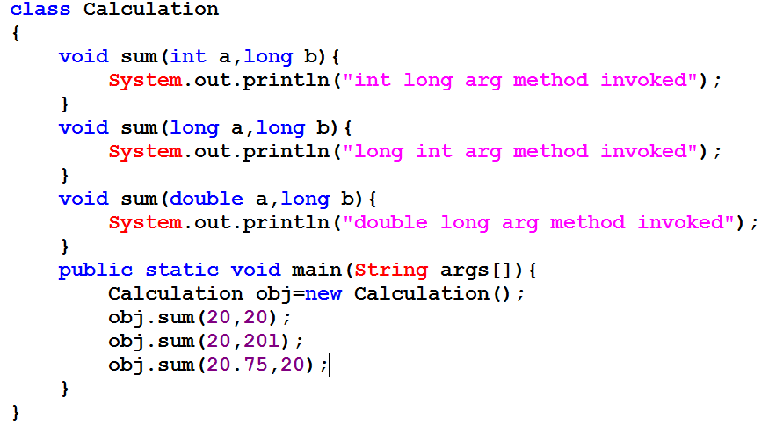
Example

Slide 60
Constructor
Constructor is a special type of method that is used to initialize the state of an object/initialize a value to instance variable.
Constructor is invoked at the time of object creation. It constructs the values i.e. data for the object that is why it is known as constructor.
Constructor is just like the instance method but it does not have any explicit return type.

Slide 61
Characteristics or Rules for Constructor
1. Constructor name must be same as its class name
2. Constructor must have no explicit return type.
3.Constructor can have arguments
4.Constructor Can be overloaded.
5.Constructor should be public but it can have other access specifier too.
5.Constructor will automatically invoke when you create object of class using new keyword.
6.Constructor cannot be call explicitly.
7.Constructor cannot be inherited.

Slide 62
Types Of Constructor
There are two types of constructors:
1) default constructor (no-arg constructor)
2) parameterized constructor
Remember Point:-
1)If you don’t provide any constructor in your class compiler will provide default constructor.
2)moment add any constructor in class u will loose to get default constructor from compiler.
3)Your class should have default constructor in case of Inheritance
4)Same constructor can be call to other constructor using this and derived class constructor using super
keyword

Slide 63
Questions
What If there is no constructor in a class, is compiler automatically creates a default constructor?
What default constructor do.
What the use of parametrize constructor
What the difference between constructor and methods.
Does constructor can have void return type?
Does copy constructor is available in java.
What the alternative of copy constructor in java?
Can constructor perform other tasks instead of initialization?

Slide 64
Static
The static keyword is used in Java mainly for memory management. We may apply static keyword with variables, methods and blocks. The static keyword belongs to the class rather than instance of the class.
The static can be:
1.variable (also known as class variable)
2.method (also known as class method)
3.block

Slide 65
Static Variable
If you declare any variable as static, it is known static variable
It is a variable which belongs to the class and not to object instance.
The static variable can be used to refer the common property of all objects (that is not unique for
each object) e.g. company name of employees,college name of students etc.
The static variable gets memory only once in class area at the time of class loading.
It can be initialize at the time of Object creation.

Slide 66
Static Variable
Static variables are initialized only once , at the start of the execution . These variables will be initialized first, before the initialization of any instance variables.
A single copy to be shared by all instances of the class
A static variable can be accessed directly by the class name and doesn’t need any object.
Syntax : <class-name>.<variable-name>.
Static variable can be final to make constant.
Syntax: public static final double RATE_OF_INT=15.5;

Slide 67
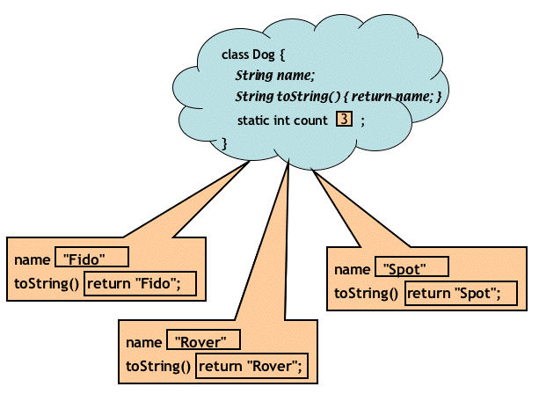
Static Variable Memory Diagram

Slide 68
Static Method
If you apply static keyword with any method, it is known as static method.
A static method belongs to the class rather than object of a class.
A static method can be invoked without the need for creating an instance of a class.
static method can access static data member and can change the value of it.
It is a method which belongs to the class and not to the object(instance)
A static method can access only static data. It can not access non-static data (instance variables)

Slide 69
Static Method
A static method can call only other static methods and can’t call a non-static method from it.
A static method can be accessed directly by the class name and doesn’t need any object but can be call by object.
Syntax : <class-name>.<method-name>
A static method cannot refer to “this” or “super” keywords in anyway.
main method is static , since it must be accessible for an application to run , before any instantiation takes place.

Slide 70
Static Block
The static block, is a block of statement inside a Java class that will be executed when a class is first loaded in to the JVM
class Test{
static {
//Code goes here
}
}
A static block helps to initialize the static data members, just like constructors help to initialize instance members

Slide 71
Questions
Que)Can we execute a program without main() method?

Slide 72
This reference in java
this keyword in Java is a special keyword which can be used to represent current object or instance of any class in Java.
“this” can also call constructor of same class in Java and used to call overloaded constructor.
if used than it must be first statement in constructor
this() will call no argument constructor.
and this(parameter) will call one argument constructor with appropriate parameter.
Example continue in next slide

Slide 73
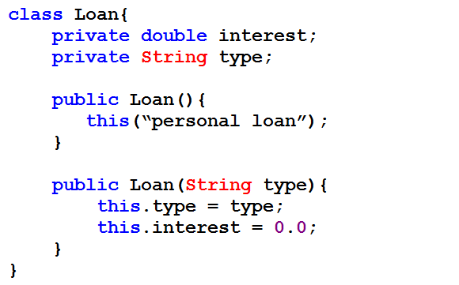
example

Slide 74
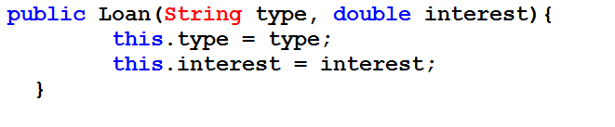
If member variable and local variable name conflict than this can be used to refer member variable.
here is an example of this with member variable:
Here local variable interest and member variable interest conflict which is easily resolve by referring member variable as this.interest

Slide 75

this is a final variable in Java and you can not assign value to this. this will result in compilation
you can call methods of class by using this keyword as shown in below example.

Slide 76

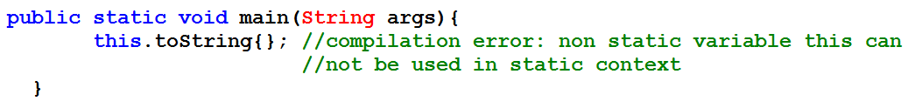
this can be used to return object. this is a valid return value.here is an example of using as return value.
"this" keyword can not be used in static context i.e.
inside static methods or static initializer block.
if use this inside static context you will get compilation
error as shown in below example:

Slide 77
this can also be passed as method parameters since it represent current object of class.
Java This can be used to get the handle of the current class
Class className = this.getClass();
Though this can also be done by, Class className = ABC.class; // here ABC refers to the class name and you need to know that!

Slide 78
Java - String Class
Strings, which are widely used in Java programming, are a sequence of characters. In the Java programming language, strings are objects.
The Java platform provides the String class to create and manipulate strings.
Creating Strings:
The most direct way to create a string is to write:
String greeting = "Hello world!";

Slide 79
String greeting = "Hello world!";
Whenever it encounters a string literal in your code, the compiler creates a String object with its value in this case, "Hello world!'.
As like any other object, you can create String objects by using the new keyword and a constructor.
The String class has eleven constructors that allow you to provide the initial value of the string using different sources

Slide 80
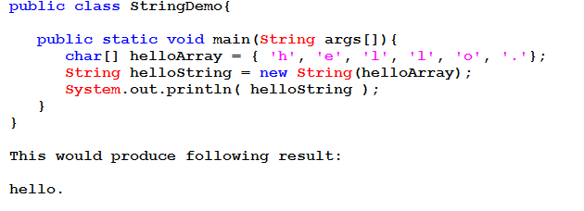
Note: The String class is immutable, so that once it is created a String object cannot be changed. If there is a necessity to make a lot of modifications to Strings of characters then you should use String Buffer & String Builder Classes.
Cont….

Slide 81
String Length:
Methods used to obtain information about an object are known as accessor methods. One accessor method that you can use with strings is the length() method, which returns the number of characters contained in the string object.
String palindrome = "Dot saw I was Tod";
int len = palindrome.length();
System.out.println( "String Length is : " + len );
o/p:- String Length is : 17

Slide 82
Concatenating Strings:
The String class includes a method for concatenating two strings:
1) method concat
2) + operator
1) string1.concat(string2);
"My name is ".concat("Zara");
"Hello," + " world" + "!"

Slide 83
char charAt(int index) Returns the character at the specified index.
int compareTo(Object o) Compares this String to another Object.
int compareTo(String anotherString) Compares two strings lexicographically.
int compareToIgnoreCase(String str) Compares two strings lexicographically, ignoring case differences.
String concat(String str) Concatenates the specified string to the end of this string.
boolean contentEquals(StringBuffer sb) Returns true if and only if this String represents the same sequence of characters as the specified StringBuffer.

Slide 84
static String copyValueOf(char[] data) Returns a String that represents the character sequence in the array specified.
static String copyValueOf(char[] data, int offset, int count) Returns a String that represents the character sequence in the array specified.
boolean endsWith(String suffix) Tests if this string ends with the specified suffix.
boolean equals(Object anObject) Compares this string to the specified object.
boolean equalsIgnoreCase(String anotherString) Compares this String to another String, ignoring case considerations.

Slide 85
byte getBytes() Encodes this String into a sequence of bytes using the platform's default charset, storing the result into a new byte array.
byte[] getBytes(String charsetName Encodes this String into a sequence of bytes using the named charset, storing the result into a new byte array.
int hashCode() Returns a hash code for this string.
int indexOf(int ch) Returns the index within this string of the first occurrence of the specified character.

Slide 86
int indexOf(int ch, int fromIndex) Returns the index within this string of the first occurrence of the specified character, starting the search at the specified index.
int indexOf(String str) Returns the index within this string of the first occurrence of the specified substring.
int indexOf(String str, int fromIndex) Returns the index within this string of the first occurrence of the specified substring, starting at the specified index.
int lastIndexOf(int ch, int fromIndex) Returns the index within this string of the last occurrence of the specified character, searching backward starting at the specified index.

Slide 87
int lastIndexOf(int ch, int fromIndex) Returns the index within this string of the last occurrence of the specified character, searching backward starting at the specified index.
int lastIndexOf(String str) Returns the index within this string of the rightmost occurrence of the specified substring.
int lastIndexOf(String str, int fromIndex) Returns the index within this string of the last occurrence of the specified substring, searching backward starting at the specified index.
int length() Returns the length of this string.

Slide 88
boolean matches(String regex) :-Tells whether or not this string matches the given regular expression.
String replace(char oldChar, char newChar) :-Returns a new string resulting from replacing all occurrences of oldChar in this string with newChar.
String replaceAll(String regex, String replacement Replaces each substring of this string that matches the given regular expression with the given replacement.
String replaceFirst(String regex, String replacement) Replaces the first substring of this string that matches the given regular expression with the given replacement.
String[] split(String regex) :-Splits this string around matches of the given regular expression.

Slide 89
boolean startsWith(String prefix) :-Tests if this string starts with the specified prefix.
boolean startsWith(String prefix, int toffset) :-Tests if this string starts with the specified prefix beginning a specified index.
String substring(int beginIndex) :-Returns a new string that is a substring of this string.
String substring(int beginIndex, int endIndex) :-Returns a new string that is a substring of this string.
char[] toCharArray() :-Converts this string to a new character array.

Slide 90
String toLowerCase() :-Converts all of the characters in this String to lower case using the rules of the default locale.
String toString() :-This object (which is already a string!) is itself returned.
String toUpperCase() :-Converts all of the characters in this String to upper case using the rules of the default locale.
String trim() :-Returns a copy of the string, with leading and trailing whitespace omitted.
static String valueOf([int][float][…….] x) :-Returns the string representation of the passed data type argument.
Continue with more details about String later

Slide 91
Inheritance
Inheritance can be defined as the process where one object acquires the properties of another.
Inheritance is a mechanism in which one object
acquires all the properties and behaviours of parent
object.
The idea behind inheritance is that you can create new classes that are built upon existing classes.
When you inherit from an existing class, you reuse (or inherit) methods and fields.
Inheritance represents the IS-A relationship.
extends keyword is used to achieve inheritance.

Slide 92
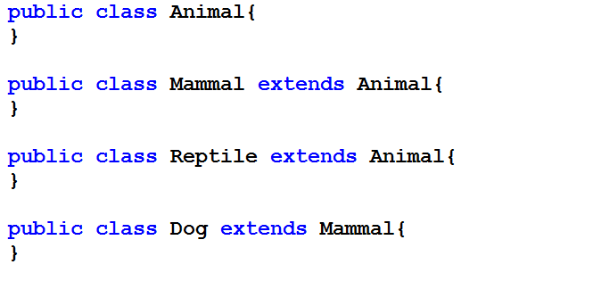
Inheritance Example
Animal is the superclass of Mammal class.
Animal is the superclass of Reptile class.
Mammal and Reptile are subclasses of Animal class.
Dog is the subclass of both Mammal and Animal classes.

Slide 93
IS-A Relationship
Mammal IS-A Animal
Reptile IS-A Animal
Dog IS-A Mammal
Hence : Dog IS-A Animal as well

Slide 94
Instanceof Operator
The instanceof operator compares an object to a specified type.
You can use it to test if an object is an instance of a class, an instance of a subclass, or an instance of a class that implements a particular interface.
The instanceof operator is also known as type
comparison operator because it compares the instance with type.
It returns either true or false.
If we apply the instanceof operator with any variable that have null value, it returns false.

Slide 95
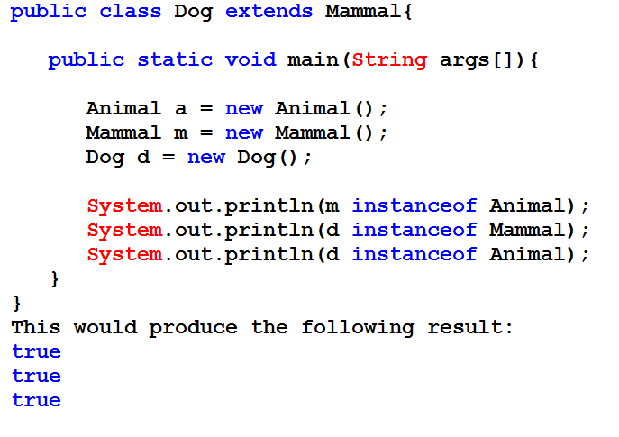
Instanceof Operator Example

Slide 96
Types of Inheritance
There exists basically three types of inheritance.
Single Inheritance
Multilevel inheritance
Multiple inheritance
Hierarchical inheritance
In single inheritance, one class extends one class only.
In multilevel inheritance, the ladder of single inheritance increases.
In multiple inheritance, one class directly extends more than one class.
In hierarchical inheritance one class is extended by more than one class.

Slide 97
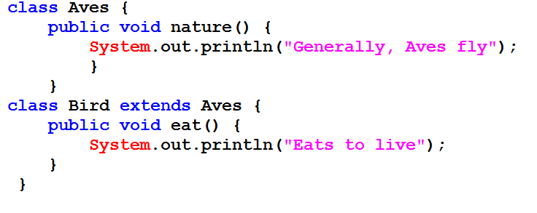
Single Inheritance

Slide 98
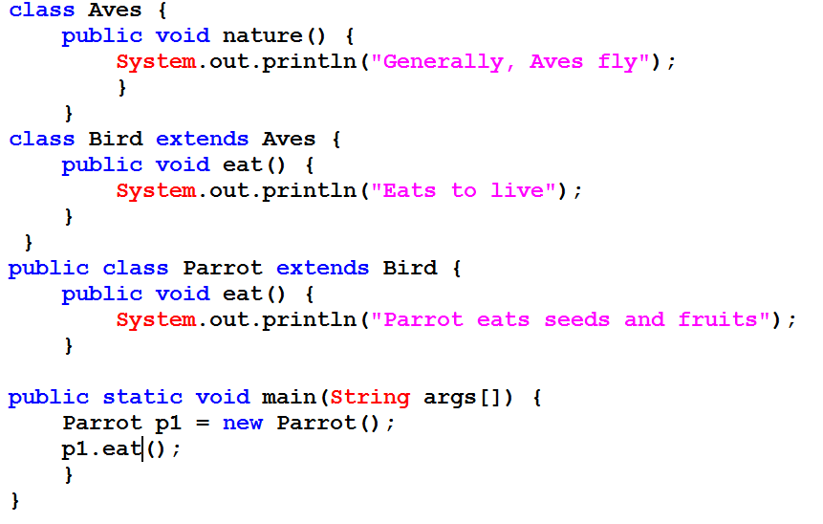
Multilevel Inheritance

Slide 99
Multilevel Inheritance

Slide 100
Multiple Inheritance
In multiple inheritance, one class extends multiple classes. Java does not support multiple inheritance but C++ supports. The above program can be modified to illustrate multiple inheritance. The following program does not work.
class Aves { }
class Bird { }
class Parrot extends Aves, Bird { }
Note:-Java supports multiple inheritance partially through interfaces.

Slide 101
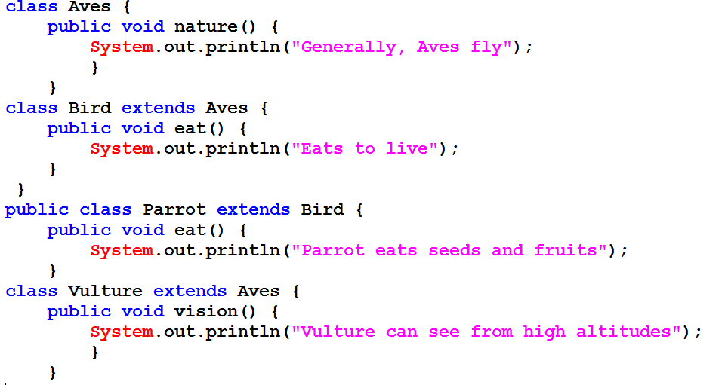
Hierarchical Inheritance

Slide 102
Disadvantages of Inheritance
Both classes (super and subclasses) are tightly-coupled.
As they are tightly coupled (binded each other strongly with extends keyword), they cannot work independently of each other.
Changing the code in super class method also affects the subclass functionality.
If super class method is deleted, the code may not work as subclass may call the super class method with super keyword. Now subclass method behaves independently.-

Slide 103
Aggregation In Java
If a class have an entity reference, it is known as Aggregation. Aggregation represents HAS-A relationship
Consider a situation, Employee object contains many informations such as id, name, emailld etc. It contains one more object named address, which contains its own informations such as city, state, country, zipcode etc. as given below.

Slide 104
Aggregation In Java
class Employee{
int id;
String name;
Address address;//Address is a class
}
In such case, Employee has an entity reference address, so relationship is Employee HAS-A address.
Why use Aggregation?
Ans:-For Code Reusability.

Slide 105
When use Aggregation?
♦ Code reuse is also best achieved by aggregation when there is no is-a relationship.
♦ Inheritance should be used only if the relationship is-a is maintained throughout the lifetime of the
objects involved; otherwise, aggregation is the best choice.

Slide 106
Overriding
In the previous chapter, we talked about super classes and sub classes.
If a class inherits a method from its super class, then there is a chance to override the method provided that it is not marked final.
The benefit of overriding is: ability to define a behavior that's specific to the subclass type which means a subclass can implement a parent class method based on its requirement.
In object-oriented terms, overriding means to override the functionality of an existing method.

Slide 107
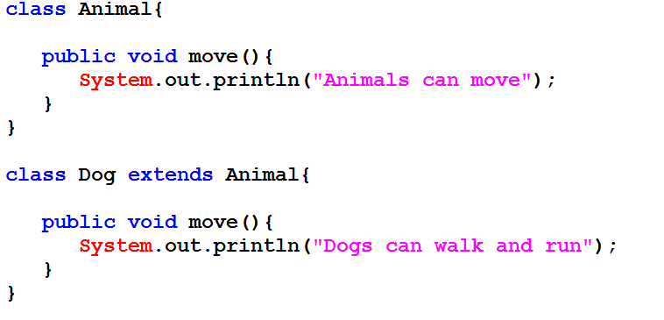

Slide 108
Rules for method overriding:
The argument list should be exactly the same as that of the overridden method.
The return type should be the same or a subtype of the return type declared in the original overridden method in the superclass.
The access level cannot be more restrictive than the overridden method's access level. For example: if the superclass method is declared public then the overridding method in the sub class cannot be either private or protected.
Instance methods can be overridden only if they are inherited by the subclass.

Slide 109
Rules for method overriding:
A method declared final cannot be overridden.
A method declared static cannot be overridden but can be re-declared.
If a method cannot be inherited, then it cannot be overridden.
A subclass within the same package as the instance's superclass can override any superclass method that is not declared private or final.
A subclass in a different package can only override the non-final methods declared public or protected.

Slide 110
Rules for method overriding:
An overriding method can throw any uncheck exceptions, regardless of whether the overridden method throws exceptions or not.
However the overriding method should not throw checked exceptions that are new or broader than the ones declared by the overridden method. The overriding method can throw narrower or fewer exceptions than the overridden method.
Constructors cannot be overridden.

Slide 111
Questions
1) Can we override static method?
No, static method cannot be overridden. It can be proved by runtime polymorphism so we will learn it later.
2) Why we cannot override static method?
because static method is bound with class whereas instance method is bound with object. Static belongs to class area and instance belongs to heap area.

Slide 112
Compare Overloading and Overriding
Method Overloading | Method Overriding
Method overloading is used to increase the readability of the program. | Method overriding is used to provide the specific implementation of the method that is already provided by its super class.
method overlaoding is performed within a class. | Method overriding occurs in two classes that have IS-A relationship.
In case of method overloading parameter must be different. | In case of method overriding parameter must be same.

Slide 113
Applying access modifier with method overriding
If you are overriding any method, overriden method (i.e. declared in subclass) must not be
more restrictive.
Access Levels are in sequence of
1)Private
2)Default
3)Protected
4)Public
Example
Cont.. Next page

Slide 114
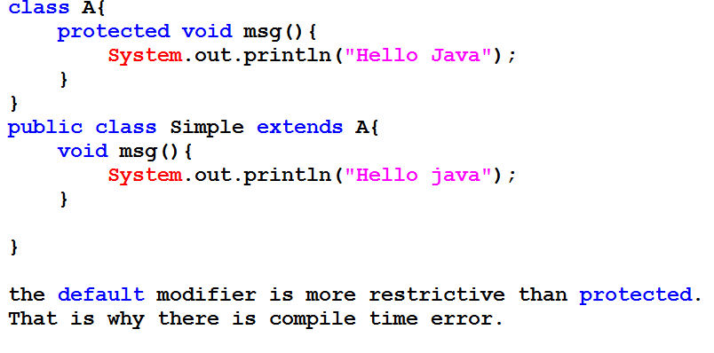

Slide 115
Covariant Return Type
The covariant return type specifies that the return type may vary in the same direction as the subclass.
Before Java5, it was not possible to override any method by changing the return type.
But now, since Java5,it is possible to override method by changing the return type if subclass overrides any method whose return type is Non-Primitive but it changes its return type to subclass type.
Let's take a simple example:

Slide 116
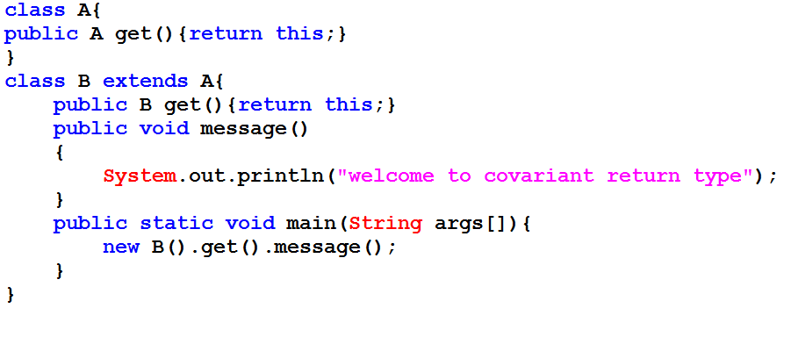

Slide 117
super keyword
The super is a reference variable that is used to refer immediate parent class object.
Whenever you create the instance of subclass, an instance of parent class is created implicitely because it is referred by super reference variable.
Usage of super Keyword:-
1. super is used to refer immediate parent class instance variable.
2. super() is used to invoke immediate parent class constructor.
3. super is used to invoke immediate parent class method.

Slide 118
Restricting Inheritance
Parent
Inherited
capability
Child

Slide 119
Final Members: A way for Preventing Overriding of Members in Subclasses
All methods and variables can be overridden by default in subclasses.
This can be prevented by declaring them as final using the keyword “final” as a modifier. For example:
final int marks = 100;
final void display();
This ensures that functionality defined in this method cannot be altered any. Similarly, the value of a final variable cannot be altered.

Slide 120
Final Classes: A way for Preventing Classes being extended
We can prevent an inheritance of classes by other classes by declaring them as final classes.
This is achieved in Java by using the keyword final as follows:
final class Marks
{ // members
}
final class Student extends Person
{ // members
}
Any attempt to inherit these classes will cause an error.

Slide 121
Abstract Classes
When we define a class to be “final”, it cannot be extended. In certain situation, we want to properties of classes to be always extended and used. Such classes are called Abstract Classes.
An Abstract class is a conceptual class.
An Abstract class cannot be instantiated – objects cannot be created.
Abstract classes provides a common root for a group of classes, nicely tied together in a package:

Slide 122
Abstract Class Syntax
abstract class ClassName{
...
abstract Type MethodName1();
…
Type Method2()
{
// method body
}
}
When a class contains one or more abstract methods, it should be declared as abstract class.
The abstract methods of an abstract class must be defined in its subclass.
We cannot declare abstract constructors or abstract static methods.

Slide 123
Abstract Class -Example
Shape is a abstract class.
Shape
Circle
Rectangle

Slide 124
The Shape Abstract Class
public abstract class Shape {
public abstract double area();
public void move() { // non-abstract method
// implementation
}
}
Is the following statement valid?
Shape s = new Shape();
No. It is illegal because the Shape class is an abstract class, which cannot be instantiated to create its objects.

Slide 125
Abstract Classes
public Circle extends Shape {
protected double r;
protected static final double PI =3.1415926535;
public Circle() { r = 1.0; )
public double area() { return PI * r * r; }
…
}
public Rectangle extends Shape {
protected double w, h;
public Rectangle() { w = 0.0; h=0.0; }
public double area() { return w * h; }
}

Slide 126
Abstract Classes Properties
A class with one or more abstract methods is automatically abstract and it cannot be instantiated.
A class declared abstract, even with no abstract methods can not be instantiated.
A subclass of an abstract class can be instantiated if it overrides all abstract methods by implementation them.
A subclass that does not implement all of the superclass abstract methods is itself abstract; and it cannot be instantiated.

Slide 127
Summary
If you do not want (properties of) your class to be extended or inherited by other classes, define it as a final class.
Java supports this is through the keyword “final”.
This is applied to classes.
You can also apply the final to only methods if you do not want anyone to override them.
If you want your class (properties/methods) to be extended by all those who want to use, then define it as an abstract class or define one or more of its methods as abstract methods.
Java supports this is through the keyword “abstract”.
This is applied to methods only.
Subclasses should implement abstract methods; otherwise, they cannot be instantiated.

Slide 128
Interface
Since we have a good understanding of the extends keyword let us look into how the implements keyword is used to get the IS-A relationship.
The implements keyword is used by classes by inherit from interfaces. Interfaces can never be extended by the classes.
An interface in the Java programming language is an abstract type that is used to specify an interface that classes must implement.
Interface is a conceptual entity similar to a Abstract class.
Can contain only constants (final variables) and abstract method (no implementation) - Different from Abstract classes.
Use when a number of classes share a common interface.
Each class should implement the interface.

Slide 129
Interface
An interface is basically a kind of class—it contains methods and variables, but they have to be only abstract classes and final fields/variables.
Therefore, it is the responsibility of the class that implements an interface to supply the code for methods.
A class can implement any number of interfaces, but cannot extend more than one class at a time.
Therefore, interfaces are considered as an informal way of realising multiple inheritance in Java.

Slide 130
Interface Example
<<Interface>>
Speaker
speak()
Politician
Priest
Lecturer
speak()
speak()
speak()

Slide 131
Interfaces Definition
Syntax (appears like abstract class):
Example:
interface InterfaceName {
// Constant/Final Variable Declaration
// Methods Declaration – only method body
}
interface Speaker {
public void speak( );
}

Slide 132
Implementing Interfaces
Interfaces are used like super-classes who properties are inherited by classes. This is achieved by creating a class that implements the given interface as follows:
class ClassName implements InterfaceName [, InterfaceName2, …]
{
// Body of Class
}

Slide 133
Implementing Interfaces Example
class Politician implements Speaker {
public void speak(){
System.out.println(“Talk politics”);
}
}
class Priest implements Speaker {
public void speak(){
System.out.println(“Religious Talks”);
}
}
class Lecturer implements Speaker {
public void speak(){
System.out.println(“Talks Object Oriented Design and Programming!”);
}
}

Slide 134
Extending Interfaces
Like classes, interfaces can also be extended. The new sub-interface will inherit all the members of the superinterface in the manner similar to classes. This is achieved by using the keyword extends as follows:
interface InterfaceName2 extends InterfaceName1 {
// Body of InterfaceName2
}

Slide 135
Inheritance and Interface Implementation
A general form of interface implementation:
This shows a class can extended another class while implementing one or more interfaces. It appears like a multiple inheritance (if we consider interfaces as special kind of classes with certain restrictions or special features).
class ClassName extends SuperClass implements InterfaceName [, InterfaceName2, …]
{
// Body of Class
}

Slide 136
Interface Cont..
Interfaces are declared using the interface keyword.
Interface may only contain method signature and constant declarations (variable declarations that are declared to be both static and final).
An interface may never contain method definitions.
Interfaces cannot be instantiated, but rather are implemented.
A class that implements an interface must implement all of the methods described in the interface, or be an abstract class.

Slide 137
Interface Cont..
Object references in Java may be specified to be of an interface type.
One benefit of using interfaces is that they simulate multiple inheritance.
All classes in Java must have exactly one base class because multiple inheritance of classes is not allowed.
A Java class may implement n number of interface.
Interface may extends n number of interface.

Slide 138
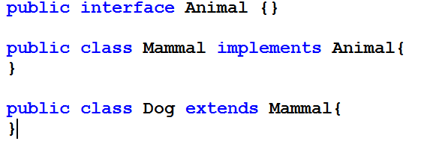
Interface Example

Slide 139
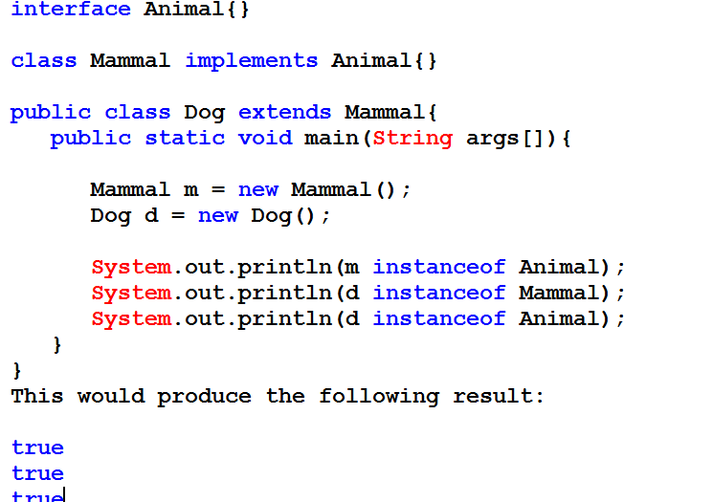
Interface Example

Slide 140
Polymorphism
Polymorphism is the ability of an object to take on many forms.
The most common use of polymorphism in OOP occurs when a parent class reference is used to refer to a child class object.
Any Java object that can pass more than one IS-A test is considered to be polymorphic.
In Java, all Java objects are polymorphic since any object will pass the IS-A test for their own type and for the class Object.

Slide 141
Polymorphism
It is important to know that the only possible way to access an object is through a reference variable.
A reference variable can be of only one type.
Once declared, the type of a reference variable cannot be changed.
The reference variable can be reassigned to other objects provided that it is not declared final.
The type of the reference variable would determine the methods that it can invoke on the object.

Slide 142
Polymorphism
A reference variable can refer to any object of its declared type or any subtype of its declared type.
A reference variable can be declared as a class or interface type.
refer example from next slide.

Slide 143
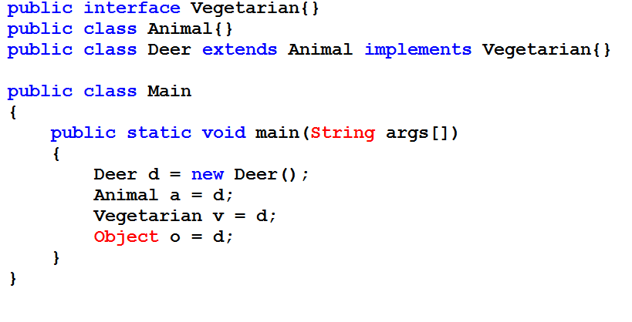
Polymorphism

Slide 144
Method Overriding Cont..
Sub class can override the methods defined by the super class.
Overridden Methods in the sub classes should have same name, same signature , same return type and may have either the same or higher scope than super class method.
Java implements Run Time Polymorphism/ Dynamic Method Dispatch by Method Overriding. [Late Binding]
Call to Overridden Methods is Resolved at Run Time.
Call to a overridden method is not decided by the type of reference variable Rather by the type of the object where reference variable is pointing.
While Overriding a Method, the sub class should assign either same or higher access level than super class method.

Slide 145
EXAMPLE METHOD OVERRIDING
class A
{
void show()
{
System.out.println("Hello This is show() in A");
}// End of show() Method
} // End of class A
class B extends A
{
void show()
{
System.out.println("Hello This is show() in B");
}// End of show() Method
} // End of class B
B class overrides show() method from super class A
class override
{
public static void main(String args[])
{
// super class reference variable
// can point to sub class object
A a1 = new A();
a1.show();
a1 = new B();
a1.show();
}
}
Call to show() of A class
Call to show() of B class

Slide 146
Is this Method
Overriding
class A
{
void show(int a)
{
System.out.println("Hello This is show() in A");
}
}
class B extends A
{
void show()
{
System.out.println("Hello This is show() in B");
}
}
class override1
{
public static void main(String args[])
{
/*
A a1 = new B();
a1.show(); */
A a1 = new A();
a1.show(10);
B b1 = new B();
b1.show(10);
b1.show(); }
NO
OUTPUT
Hello This is show() in A
Hello This is show() in A
Hello This is show() in B

Slide 147
Dynamic Method Dispatch
Super class reference variable can refer to a sub class object.
Super class variable if refers to sub class object can call only overridden methods.
Call to an overridden method is decided by the type of object referred to.
A
A a1 = new B();
a1.show(); // call to show() of B
a1 = new C();
a1.show(); // call to show() of C
a1 = new D();
a1.show(); // call to show() of D
B
C
D
Assume show() Method is
Overridden by sub classes

Slide 148
DYNAMIC METHOD DISPATCH
class A
{
void show()
{
System.out.println("Hello This is show() in A");
}
}
class B extends A
{
void show()
{
System.out.println("Hello This is show() in B");
}
}
class C extends A
{
void show()
{
System.out.println("Hello This is show() in C");
}
}
class D extends A
{
void show()
{
System.out.println("Hello This is show() in D");
}
}
CONTINUED…..

Slide 149
class override2
{
public static void main(String args[])
{
A a1 = new A();
a1.show();
a1 = new B();
a1.show();
a1 = new C();
a1.show();
a1 = new D();
a1.show();
}
}
Hello This is show() in A
Hello This is show() in B
Hello This is show() in C
Hello This is show() in D

Slide 150
class override3
{
public static void main(String args[])
{
A a1 = new B();
B b1 = (B) a1;
/*
A a1 = new B();
C c1 = (C) a1;
Exception in thread "main"
java.lang.ClassCastException: B
at override3.main(override3.java:39)
*/
}
}

Slide 151
Examples Overriding
class A
{
void show() { …. }
}
class B extends A
{
void show() { …. }
void show(int x) { … }
void print() { … }
}
A a1 = new B();
a1.show() ; // Valid
// a1.show(10); // Invalid
//a1.print(); // Invalid
When a super class variable points to a sub class object, then it can only call overridden methods of the sub class.

Slide 152
class A
{
protected void show()
{
System.out.println("Hi");
}
}
class B extends A
{
void show()
{
System.out.println("Hi");
}
}
D:\Java1>javac AB.java
AB.java:10: show() in B cannot override show() in A; attempting to assign weaker
access privileges; was protected
void show()
^
1 error

Slide 153
IS THIS METHOD OVERRIDING
class A{
private void show(){
System.out.println("Hi");
}
}
class B extends A{
int show(){
System.out.println("Hi");
return 10;
}
}
NO
CODE WILL COMPILE & RUN SUCESSFULLY

Slide 154
class A{
static int show(){
System.out.println("class A");
return 0;
}
}
class B extends A{
void show(){
System.out.println("class B");
}
}
What’s Wrong Here
sample.java:12: show() in B cannot override show() in A; overridden method is static
void show()
^
1 error

Slide 155
Nested Classes
Java programming language allows you to define a class within another class
Enclosing Class OR Outer Class
class OuterClass
{ ...
class NestedClass { ... }
}
A nested class is a member
of its enclosing class
Nested Class
Nested has access to other members of the
enclosing class,even if they are declared private
2. Can be private, public, protected or friendly
access

Slide 156
Nested Class Types
Static nested classes
Static keyword applied for class declaration
Static nested class can use the instance fields/methods of the outer class only through object reference.
Static nested class can be accessed
OuterClass.StaticNestedClass
4. To create an object for the static nested class, use this syntax:
OuterClass.StaticNestedClass nestedObject = new OuterClass.StaticNestedClass();

Slide 157
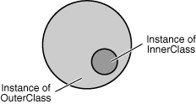
Nested Class Types cont..
Non-Static nested classes
These nested classes do not have static keyword applied
Non-Static nested class can use the instance fields/methods of the outer class directly.
3. To create an object for the non-static nested class, use this syntax:
OuterClass.NestedClass nestedObject = Outerobjectreference. new innerclass();
Inner class instance can
only exists inside
Outer class instance.

Slide 158
Example 1 [Non-static Nested Class]
class A
{
private int a;
A(int a)
{
this.a =a;
}
void print()
{
System.out.println("a="+a);
}
class B
{
int b;
B(int b)
{
int c = b+10;
this.b = c;
}
void show()
{
print();
System.out.println("b="+b);
}
} // End of class B
} // End of class A
Outer Class
Nested class with friendly access
Call to print() of outer class

Slide 159
Example 1 [Non-static Nested Class] cont….
class innertest1
{
public static void main(String args[])
{
A a1 = new A(10);
A.B b1 = a1.new B(100);
b1.show();
}
}
Inner class Name
Outer class Reference
To create an inner class instance for non-static classes you need an outer class reference.
Inner class Reference
Outer class Name
If class B is Private then it is not visible in main().
A.B b1 = a1.new B(100); is WRONG/INVALID

Slide 160
Example 2

Slide 161
class A
{
private int a;
private int b=10;
A(int a)
{
this.a=a;
}
Outer class
Nested Inner class [Non-static Type]
class B
{
private int b;
B(int b)
{
this.b =b;
}
void show()
{
int b=20;
System.out.println("a="+a);
System.out.println("b="+b);
System.out.println("this.b="+this.b);
System.out.println("Outer b="+A.this.b);
}
} // End of B inner class
Instance Field of B
Outer Class A’s a
Local b
B’s instance Field b
A’s instance Field b
void show()
{
B b1 = new B(30);
b1.show();
}
} // End of Outer class A

Slide 162
class innerTest
{
public static void main(String args[])
{
// Create an inner class B's instance
// Call show() method
// STEP 1
// Create an Outer Instance first
A a1 = new A(20);
A.B b1 = a1.new B(-30);
b1.show();
// inner class object instantiation thru anonymous outer
// reference
A.B b2 = new A(30).new B(-40);
b2.show();
}
}
a=20
b=20
this.b=-30
Outer b=10
a=30
b=20
this.b=-40
Outer b=10

Slide 163
Static Inner class / Static Nested class Example
static class B
{
int b;
B(int b)
{
int c = b+10;
this.b = c;
}
void show()
{
// print(); INVALID
A a1 = new A(10);
a1.print();
System.out.println("b="+b);
} } // End of class B
} // End of class A
class A
{
private int a;
A(int a)
{
this.a =a;
}
void print()
{
System.out.println("a="+a);
}
Static inner class
Static nested class can refere to outer members only through outer reference

Slide 164
Example cont….
class innertest10
{
public static void main(String args[])
{
A.B b1 = new A.B(100);
b1.show();
}
}
Instance of static Inner class

Slide 165
Static Nested class Example 2
class A{
private int a;
protected static int b=10;
A(int a){
this.a=a;
}
public void show()
{
System.out.println("a="+a);
display();
}
public static void display()
{
System.out.println("b="+b);
}
}

Slide 166
Example 2 cont….
static class B {
private int a;
protected static int b=100;
B(int a){
this.a=a;
}
void show(){
// A.this.show(); // Won't work show() is non-static in outer
display(); // Will work as method is static in outer
System.out.println("a="+a);
// System.out.println("a="+A.this.a);
// Won't work a is non-static in outer
System.out.println("b="+b); // Will refer to its own b
System.out.println("A'sb="+A.b); // will refer to outer class B
new A(40).show();
// This is how you can call non static methods of outer
}
} // End of inner class B
} // End of class A

Slide 167
Example 2 cont….
class innerTest1
{
public static void main(String args[])
{
A.B b1 = new A.B(-30);
b1.show();
}
}
D:\jdk1.3\bin>java innerTest1
b=10
a=-30
b=100
A'sb=10
a=40
b=10

Slide 168
Local Inner classes [ Classes Within method body]
Class declared within a method body.
Here method is show()
Local inner classes Can not be declared as public,private or protected
class A
{
private int a;
protected static int b=10;
A(int a)
{
this.a=a;
}
void show()
{
class B
{}
}
}
Class B is visible only in method show().
It can be used within this show() method only
Local inner classes can only use final variables from its enclosing method.
However inner classes can refer to its fields of enclosing class.

Slide 169
class A
{
private int a;
protected static int b=10;
A(int a)
{
this.a=a;
}
void show()
{
int x=10;
} // End of show() method
} // End of A class
D:\jdk1.3\bin>javac innerTest2.java
innerTest2.java:23: local variable x is accessed from within inner class;
to be declared final
System.out.println("x="+x);
^
1 error
class B
{
private int b;
B(int b)
{
this.b=b;
}
void display()
{
System.out.println("a="+a);
System.out.println("b="+b);
System.out.println("x="+x);
}
} // End of class B
Reference for A’s a
Reference for B’s b
Reference is wrong / errorneous
‘x’ is local variable inside the local method. Local classes can use only final fields from enclosing method

Slide 170
class innertest
{
public static void main(String args[])
{
final int a1=10;
class A
{
private int a;
private int b;
int c;
A(int a)
{
this.a =a;
b = a+20;
c = a+40;
}
void show()
{
System.out.println("a1="+a1);
System.out.println("a="+a);
System.out.println("b="+b);
System.out.println("c="+c);
}
} //End of A
new A(20).show();
print();
}// End of main
static void print()
{
/*
A a1 = new A(30);
a1.show();
*/
System.out.println("Hello");
}
}

Slide 171
OUTPUT
E:\oop>java innertest
a1=10
a=20
b=40
c=60
Hello

Slide 172
Anonymous Inner classes
Another category of local inner classes
Classes without any name i.e classes having no name
Can either implements an interface or extends a class.
Can not have more than one instance active at a time.
Whole body of the class is declared in a single statement ending with ;

Slide 173
Cont…
Syntax [ If extending a class]
[variable_type_superclass =] new superclass_name() {
// properties and methods
} [;]
Syntax [ If implementing an interface]
[variable_type_reference =] new reference_name() {
// properties and methods
} [;]

Slide 174
Anonymous Inner Class Example
class A
{
private int a;
A(int a)
{
this.a =a;
}
void show()
{
System.out.println("a="+a);
} // End of show()
}// End of class A

Slide 175
class innertest1
{
public static void main(String args[])
{
A a1 = new A(20){
public void show()
{
super.show();
System.out.println("Hello");
}
public void display()
{
System.out.println("Hi");
}
};
a1.show();
// a1.display();
}
}
Anonymous inner class extending super class A
Calling show from inner class

Slide 176
interface X{
int sum(int a,int b);
int mul(int x,int y);
}
class innertest2{
public static void main(String args[]){
X x1 = new X()
{
public int sum(int a,int b)
{
return a+b;
}
public int mul(int a,int b)
{
return a*b;
}
};
System.out.println(x1.sum(10,20));
System.out.println(x1.mul(10,20));
}// End of main
}// End of innertest2
Anonymous inner class implementing an interface

